Slide 1

Language Paper 1
Creative Writing
Descriptive and Story Writing

Slide 2
Assessment Objectives
AO5
Communicate clearly, effectively and imaginatively, selecting and adapting tone, style and register for different forms, purposes and audiences.
Organise information and ideas, using structural and grammatical features to support coherence and cohesion of texts.
AO6
Candidates must use a range of vocabulary and sentence structures for clarity, purpose and effect, with accurate spelling and punctuation.
Notes:
2

Slide 3
Starter Activity
Can you think of some ways in which we can add interest to our writing and make it more imaginative?
Notes:
Give students 5 minutes to jot down their thoughts and share with the group before the showing the next slide
3

Slide 4
We could include:
Sensory Language
Imagery
Linguistic Devices
Structural Devices
Her large, grave, wistfully attentive eyes darted across the room.
Her hand pointed to the dark cloud over London where the sky hung low like old bruises.
Her face lit up as broad bars of golden light streamed into her room.
Dressed in her heavy tweed jacket, she coughs uncontrollably as the white woolly fog crept closer and closer.
Notes:
Use this slide to introduce or consolidate the concept of imaginative writing
Point to the linguistic and structural devices
4

Slide 5
Recipe for writing interesting sentences and Paragraphs about characters
Start with an interesting sentence starter
Add a sensory adjective or
Add a powerful verb or
Add an adverb
Add an embedded clause or subordinate clause
Add dialogue ( minimal)
Add a Metaphor/ Alliteration / Simile/ Sibilance/ Personification
Include Pathetic fallacy
Add Juxtaposition
Use long and short sentences for effect
Notes:
Reiterate some of the techniques that may be used to create interesting and imaginative sentences and paragraphs
Introduce them to the next slide which has worked example
5

Slide 6
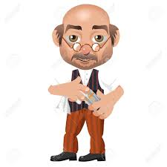
Use CLAMPS – to describe a character
AeAppearance
Movements / Behaviours Attitudes
iLikes and Dislikes
Personality
Strengths and Weaknesses
Clothing and garments

Slide 7
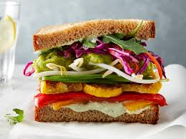
Use Clauses to add more detail
Embedded Clause
Subordinate Clause
The boy, in the blue jumper, played outside
Sandwich clause – information in the middle to add interest
Although it was freezing, the children played outside.
Notes:
Explain how the embedded clause works to give more details about the subject
7

Slide 8
Let’s look at writing about ‘table’ in and imaginative way?
Example: Table ( noun)
The table stood in the middle of the room
The old oak table stood in the middle of the room
The old oak table, which was one hundred years old, stood in the middle of the room.
The old oak table, which was one hundred years old, stood elegantly in the middle of the room.
Like royalty, the oak table, which was one hundred years old, stood elegantly in the middle of the room.
Notes:
Reminder to students:
Reviision of what they already know – reminder of what you should already know
What is the thing we’re talking about in this example
Talk about the main building blocks of meaning vi. The humble noun - in this case – ‘table ‘
8

Slide 9
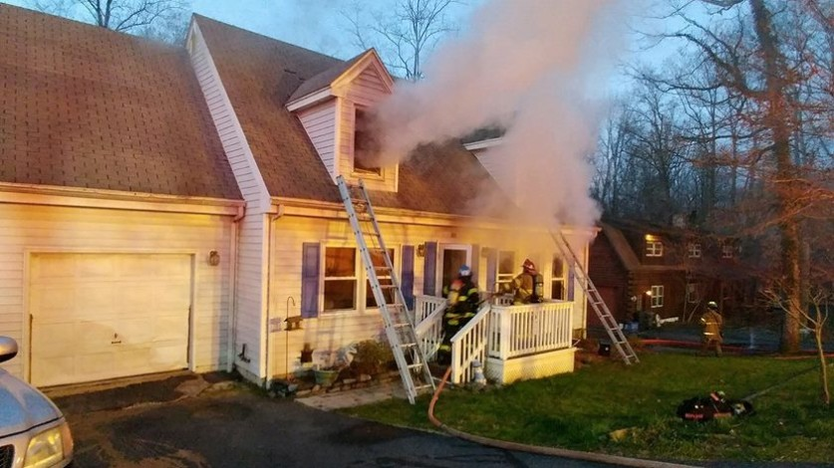
House on Fire
Can you think of some Nouns associated with this picture

Slide 10
Planning Page
Notes:
Draw a quadrant around the picture for student to start writing notes about
10

Slide 11
Flicker
Wood
Lungs
Matches
Smog
Flame
blaze
Ladder
Wood
Smoke
Onlookers
Ash
Remains
Cinders
Heat
Debris
Siren
grass
Charcoal
woods
Furniture
carpets
Clouds
Darkness
Breath
Moon
Chaos
Forest
Trees
Sky
doors
destruction
Inferno
devastation
explosion
Screams
Family
Firemen
Hose
wind
Windows
sparks

Slide 12
Let’s write 3 Imaginative sentences with any of the nouns you have written down
Remember:
Try to use as many Imaginative writing techniques as you need to make your sentences interesting
Example:
The acrid stench of burning wood filled the air.
The small, frail figure moved, inch by inch to the door.

Slide 13
Flames
Write a simple sentence
Start with an interesting sentence starter
Add an adjective
Add a powerful verb
Add an adverb
Add an embedded clause
Add a simile
Add dialogue
The flames darted upwards.
Like a hungry beast, the pulsating flames , which were enormous, devoured the house.
Help! Help!’ screamed the man, as he waved frantically at the window.
Can you add more ….

Slide 14
Now let’s create a paragraph that includes:
An interesting sentence starter and
A sensory adjective or
A powerful/ emotive verb or
An adverb or
A pathetic fallacy or
A simile or
A metaphor or
An embedded clause

